Slide 1
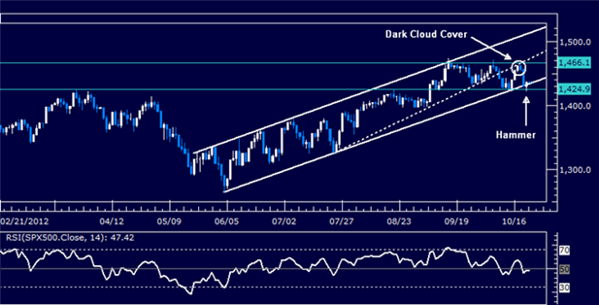
Lecture 10: Efficient market hypothesis
HE Tai-Sen
FINANCIAL ECONOMICS

Slide 2
Efficient Market Hypothesis
Outline
Efficient Market Hypothesis (EMH) (11.1, 11.2)
Three Versions of the EMH (11.1, 11.2)
Implications of the EMH (11.1, 11.2)
Market Efficiency Anomalies

Slide 3
Efficient Market Hypothesis
Efficient Market Hypothesis
Question: Suppose you've acquired and mastered both fundamental and technical analysis skills. Do you think that you can use these skills to predict stock movement and achieve abnormal profits by consistently beating the market?
The answer to this question is extremely important. Why?

Slide 4
Efficient Market Hypothesis
Efficient Market Hypothesis
In 1960s, Eugene F. Fama proposed and demonstrated the Efficient Market Hypothesis (EMH), which states that stock prices reflect all available information. This hypothesis suggests that:
New information affects prices almost immediately.
Stock price movements are impossible to predict using any available information.
Eugene F. Fama was awarded the Nobel Prize in Economics in 2013 for his contribution in EMH.

Slide 5
Efficient Market Hypothesis
Three Versions of EMH
Weak-form EMH: stock prices already reflect all information that can be derived by examining market trading data such as the history of past prices and trading volume (past market data or past information).
The implication of the weak-form EMH is that technical analysis cannot be used to predict and beat the market.

Slide 6
Efficient Market Hypothesis
Three Versions of EMH
Semistrong-form EMH: stock prices already reflect all publicly available information regarding the prospects of a firm (e.g., financial statement data, company announcements, analyst reports, and past market data) must be reflected already in the stock price (public information).
The implication of the semistrong-form EMH is that fundamental analysis cannot be used to predict and beat the market.

Slide 7
Efficient Market Hypothesis
Three Versions of EMH
Strong-form EMH: stock prices already reflect all information relevant to the firm, even including information available only to company insiders. (public and private information).
The implication of the strong-form EMH is that insider information cannot be used to predict and beat the market.
trading based on insider information is illegal.

Slide 8
Efficient Market Hypothesis
Implications of the EMH
Implications on portfolio management:
Proponents of the efficient market hypothesis believe that active management is largely wasted effort and unlikely to justify the expenses incurred. Therefore, they advocate passive investment strategy that makes no attempt to outsmart the market.
A passive investment strategy aims only at establishing a well-diversified portfolio of securities (index fund) without attempting to find under- or overvalued stocks.
“A lifetime of experience in this business makes me profoundly skeptical of market timing. I don’t know anyone who can do it successfully, nor anyone who has done so in the past.”---John C. Bogle
Notes:
Should fund managers ACTIVELY choose stocks that are undervalued?
If market is efficient? They shouldn’t. Invest in a well-diversifed portfolio without attempting to outperform the market

Slide 9
Efficient Market Hypothesis
Market Efficiency Anomalies
Market Efficiency Anomalies (link; market anomalies) :
P/E effect: investors can profit by investing in stocks with a low P/E ratio.
Size effect: smaller companies have greater returns than their larger peers (on a risk-adjusted basis).
January effect: investors can profit by buying stocks in December and selling them in January.
Post–earnings-announcement drift: the tendency for a stock’s cumulative abnormal returns to drift in the direction of an earnings surprise for several weeks (even several months) following an earnings announcement.
The popularity of active asset management: Only about 10%-15% of the equity in the mutual fund industry is held in indexed accounts, even though studies have shown that actively managed equity mutual funds have provided investors with average returns significantly below those on passive benchmarks.
Notes:
Should fund managers ACTIVELY choose stocks that are undervalued?
If market is efficient? They shouldn’t. Invest in a well-diversifed portfolio without attempting to outperform the market

Slide 10
Efficient Market Hypothesis
Market Efficiency Anomalies
However, whether the market is efficient is highly controversial and often disputed. Watch these two video clips: 1) How Efficient are Markets Really? 2) Are markets efficient?

